Slide 1
MY JOURNEY TO PYTHON
NAME:卡納門 4110E207
TEACHER: MY DEAR GREAT TEACHERS

Slide 2
AGENDA
Python Syntax
Python Comments
Python Variables
Python Data Types
Python Numbers
Python Casting
Python Strings
Python Booleans
Python Operators
Python Lists
Python Tuples

Slide 3
python

Slide 4
python
Python is a popular programming language. It was created by Guido van Rossum, and released in 1991.
It is used for:
web development (server-side),
Software development,
mathematics,
system scripting.

Slide 5
What can Python do?
Python can be used on a server to create web applications.
Python can be used alongside software to create workflows.
Python can connect to database systems. It can also read and modify files.
Python can be used to handle big data and perform complex mathematics.
Python can be used for rapid prototyping, or for production-ready software development.

Slide 6
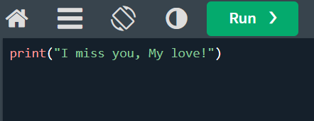

Example:

Slide 7
Python Syntax

Slide 8


Python Syntax
Execute python syntax
As we learned in the previous page, Python syntax can be executed by writing directly in the Command Line:
Or by creating a python file on the server, using the .py file extension, and running it in the Command Line:

Slide 9
Python Indentation
Indentation refers to the spaces at the beginning of a code line.
Where in other programming languages the indentation in code is for readability only, the indentation in Python is very important.
Python uses indentation to indicate a block of code.

Slide 10
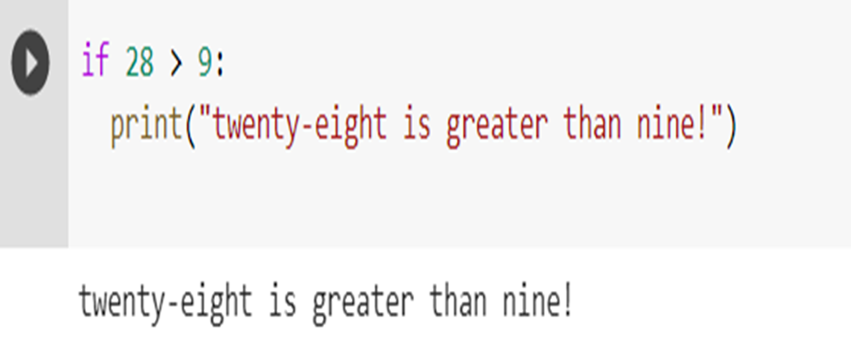
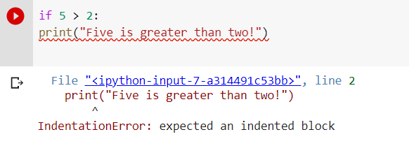
Example:
Python will give you an error if you skip the indentation:
Example
Syntax Error:

Slide 11
Python Comments

Slide 12
Python Comments
Comments can be used to explain Python code.
Comments can be used to make the code more readable.
Comments can be used to prevent execution when testing code.

Slide 13
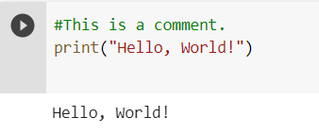
Creating a Comment
Comments starts with a #, and Python will ignore them:
Example:

Slide 14
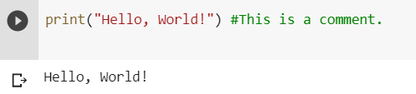
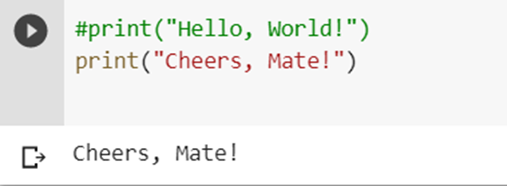
Comments can be placed at the end of a line, and Python will ignore the rest of the line:
Example:
A comment does not have to be text that explains the code, it can also be used to prevent Python from executing code:
Example:

Slide 15
Python variables

Slide 16
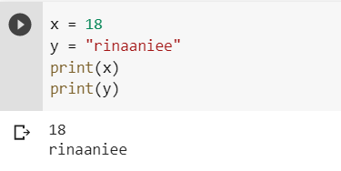
Python Variables
Variables are containers for storing data values.
Creating Variables
Python has no command for declaring a variable.
A variable is created the moment you first assign a value to it.
Example:

Slide 17
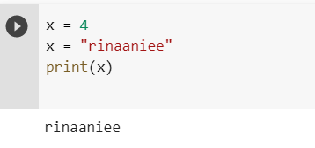
Variables do not need to be declared with any particular type, and can even change type after they have been set.
Example:

Slide 18
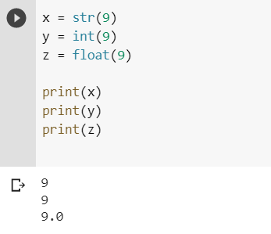
Casting
If you want to specify the data type of a variable, this can be done with casting.
Example:

Slide 19
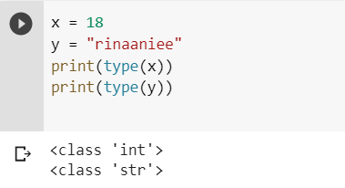
Get the Type
You can get the data type of a variable with the type() function.
Example:

Slide 20
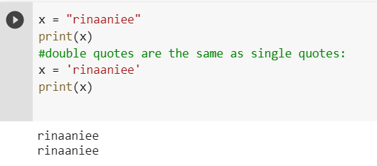
Single or Double Quotes?
String variables can be declared either by using single or double quotes:
Example:

Slide 21
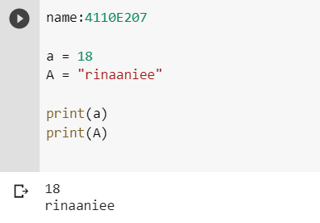
Case-Sensitive
Variable names are case-sensitive.
Example:

Slide 22
Python - Variable Names
Variable Names
A variable can have a short name (like x and y) or a more descriptive name (age, carname, total_volume). Rules for Python variables:
A variable name must start with a letter or the underscore character
A variable name cannot start with a number
A variable name can only contain alpha-numeric characters and underscores (A-z, 0-9, and _ )
Variable names are case-sensitive (age, Age and AGE are three different variables)
Example

Slide 23
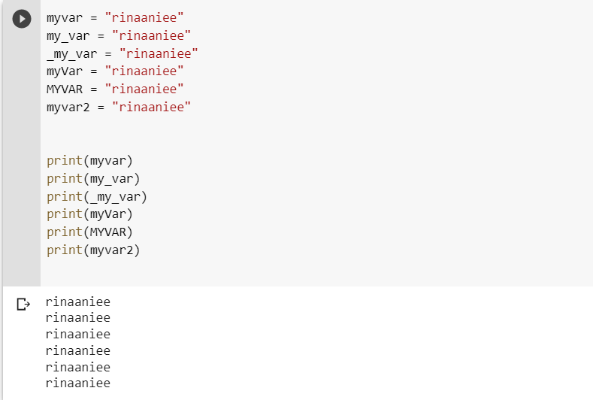
Legal variable names:
Example:

Slide 24
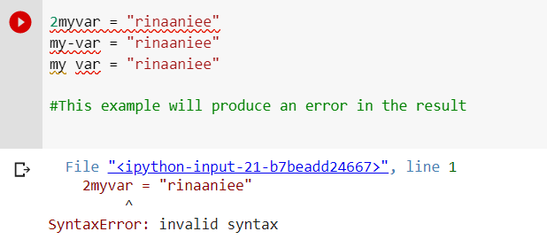
Illegal variable names:
Example:

Slide 25

Multi Words Variable Names
Variable names with more than one word can be difficult to read.
There are several techniques you can use to make them more readable:
Camel Case
Each word, except the first, starts with a capital letter:

Slide 26


Pascal Case
Each word starts with a capital letter:
Snake Case
Each word is separated by an underscore character:

Slide 27
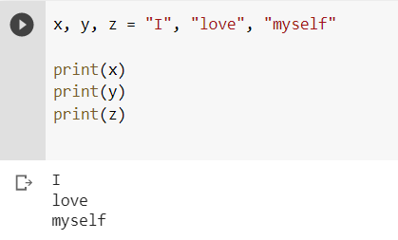
Python Variables - Assign Multiple Values
Many Values to Multiple Variables
Python allows you to assign values to multiple variables in one line:
Example:

Slide 28
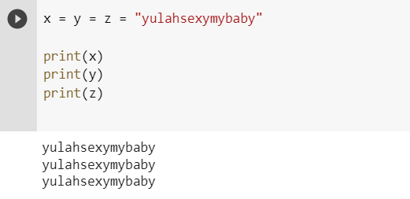
One Value to Multiple Variables
And you can assign the same value to multiple variables in one line:
Example:

Slide 29
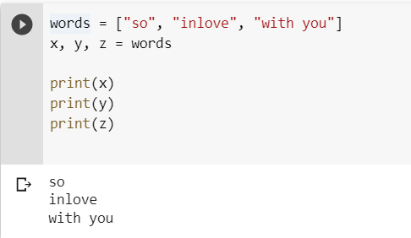
Unpack a Collection
If you have a collection of values in a list, tuple etc. Python allows you to extract the values into variables. This is called unpacking.
Example
Unpack a list:

Slide 30
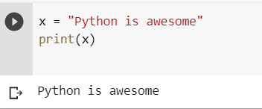
Python - Output Variables
Output Variables
The Python print() function is often used to output variables.
Example:

Slide 31
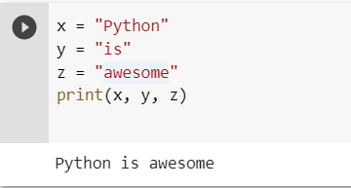
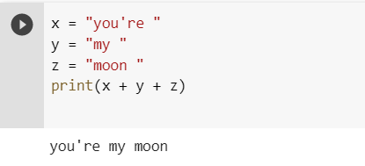
In the print() function, you output multiple variables, separated by a comm:
Example:
You can also use the + operator to output multiple variables:
Example:

Slide 32
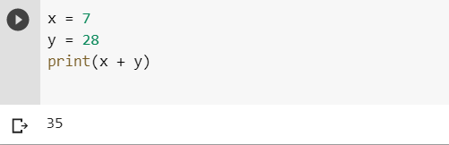
Notice the space character after "Python " and "is ", without them the result would be "Pythonisawesome".
For numbers, the + character works as a mathematical operator:
Example:

Slide 33
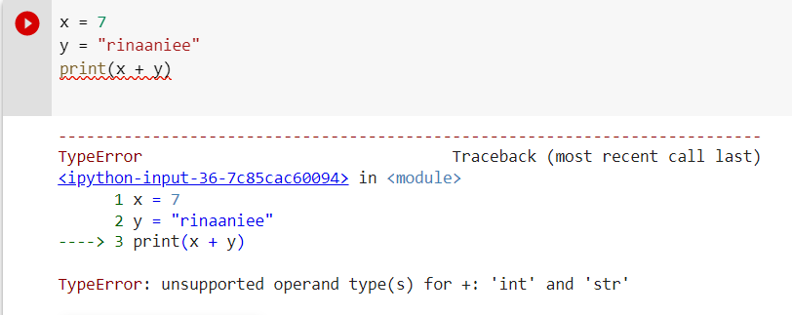
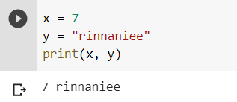
In the print() function, when you try to combine a string and a number with the + operator, Python will give you an error:
Example:
The best way to output multiple variables in the print() function is to separate them with commas, which even support different data types:
Example:

Slide 34
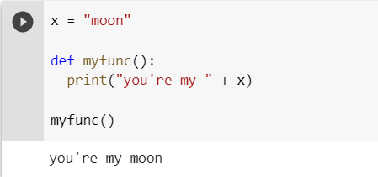
Python - Global Variables
Global Variables
Variables that are created outside of a function (as in all of the examples above) are known as global variables.
Global variables can be used by everyone, both inside of functions and outside.
Example:
Create a variable outside of a function, and use it inside the function.

Slide 35
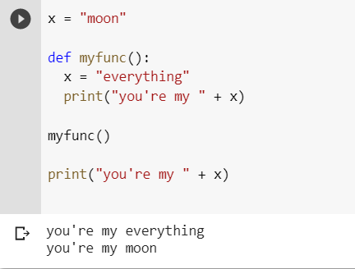
If you create a variable with the same name inside a function, this variable will be local, and can only be used inside the function. The global variable with the same name will remain as it was, global and with the original value.
Example:
Create a variable inside a function, with the same name as the global variable.

Slide 36
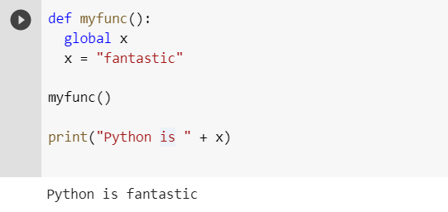
The global Keyword
Normally, when you create a variable inside a function, that variable is local, and can only be used inside that function.
To create a global variable inside a function, you can use the global keyword.
Example:
If you use the global keyword, the variable belongs to the global scope:

Slide 37
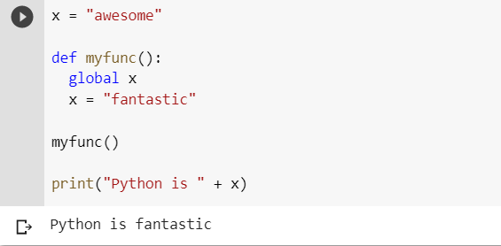
Also, use the global keyword if you want to change a global variable inside a function.
Example:
To change the value of a global variable inside a function, refer to the variable by using the global keyword:

Slide 38
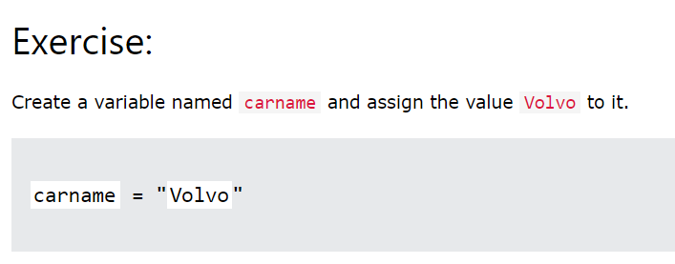
Python - Variable Exercises
Test Yourself With Exercises
Now you have learned a lot about variables, and how to use them in Python.
Are you ready for a test?
Try to insert the missing part to make the code work as expected:

Slide 39
Python Data Types

Slide 40
Python Data Types
Built-in Data Types
In programming, data type is an important concept.
Variables can store data of different types, and different types can do different things.
Python has the following data types built-in by default, in these categories:

Slide 41
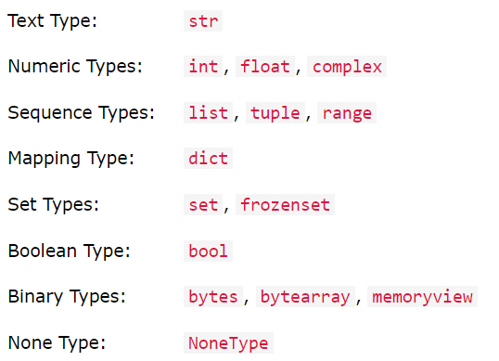


Slide 42
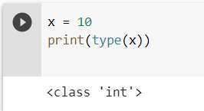
Getting the Data Type You can get the data type of any object by using the type() function:
Example:

Slide 43
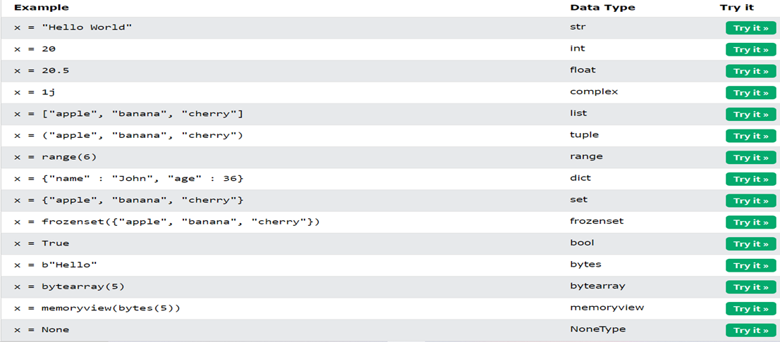
Setting the Data Type
In Python, the data type is set when you assign a value to a variable:

Slide 44
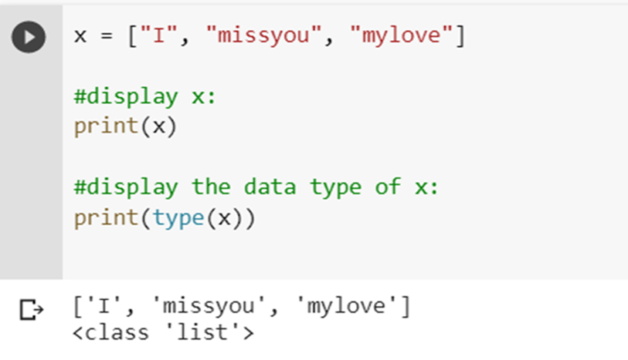
List example:

Slide 45
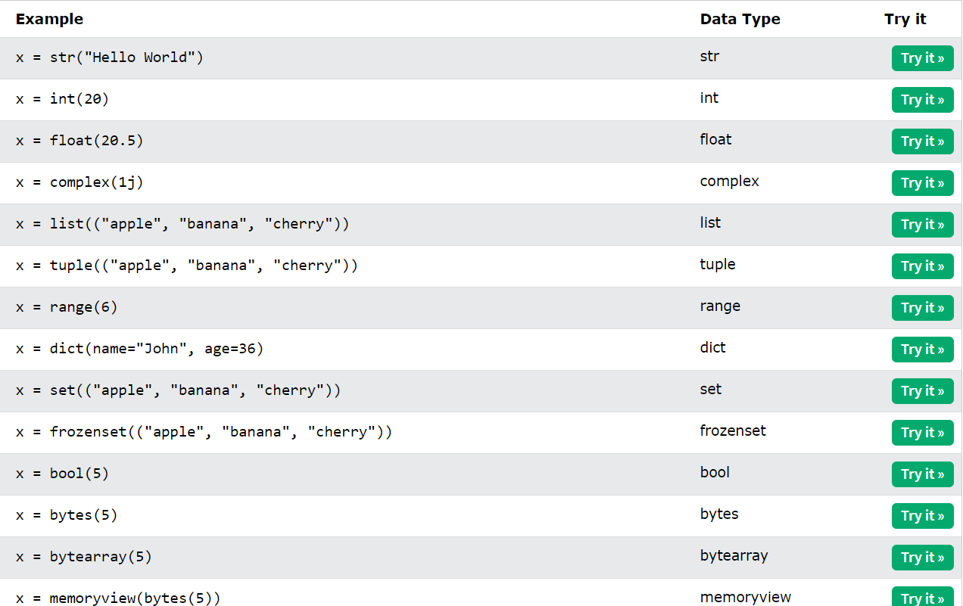
Setting the Specific Data Type
If you want to specify the data type, you can use the following constructor functions:

Slide 46
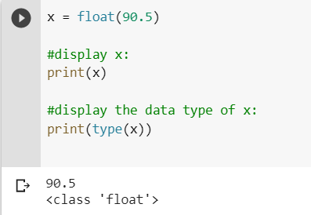
Float examples:

Slide 47
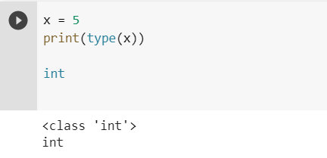
Exercise:
The following code example would print the data type of x, what data type would that be?
data type

Slide 48
Python Numbers

Slide 49

Python Numbers
There are three numeric types in Python:
int
float
complex
Variables of numeric types are created when you assign a value to them:
Example:

Slide 50
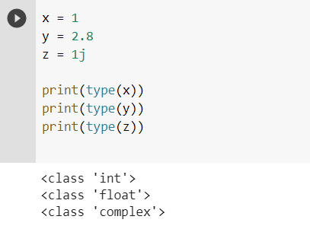
To verify the type of any object in Python, use the type() function:
Example:

Slide 51
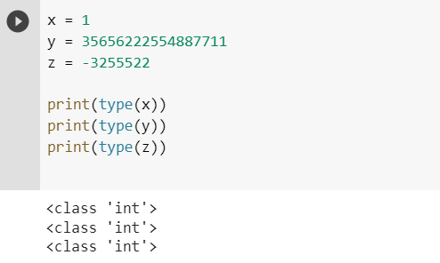
Int
Int, or integer, is a whole number, positive or negative, without decimals, of unlimited length.
Integers example:

Slide 52
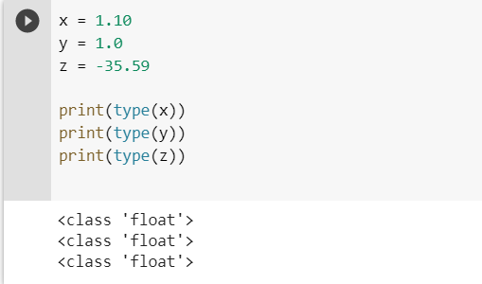
Float
Float, or "floating point number" is a number, positive or negative, containing one or more decimals.
Floats example:

Slide 53
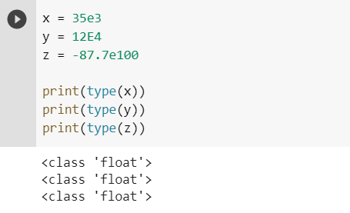
Float can also be scientific numbers with an "e" to indicate the power of 10.
Example:

Slide 54
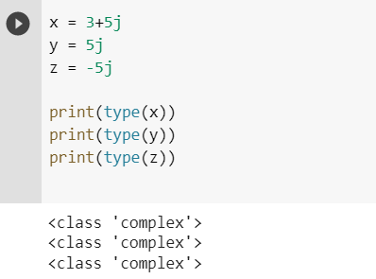
Complex
Complex numbers are written with a "j" as the imaginary part:
Complex example:

Slide 55
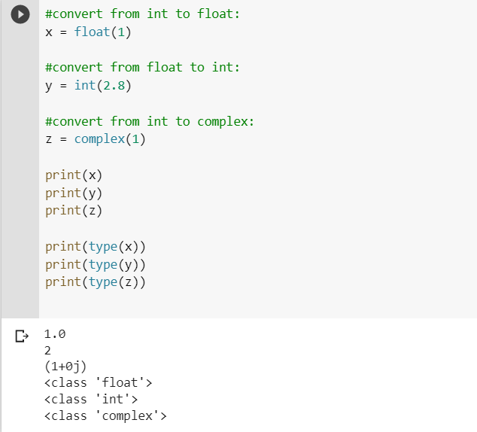
Type Conversion
Note: You cannot convert complex numbers into another number type.
Convert from one type to another example:
Note: You cannot convert complex numbers into another number type.

Slide 56
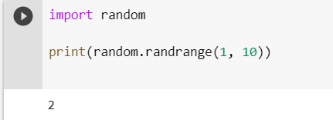
Random Number
Python does not have a random() function to make a random number, but Python has a built-in module called random that can be used to make random numbers:
Example:
Import the random module, and display a random number between 1 and 9:

Slide 57

Exercise:
Insert the correct syntax to convert x into a floating point number.
correct syntax

Slide 58
Python Casting

Slide 59
Specify a Variable Type
There may be times when you want to specify a type on to a variable. This can be done with casting. Python is an object-orientated language, and as such it uses classes to define data types, including its primitive types.
Casting in python is therefore done using constructor functions:
int() - constructs an integer number from an integer literal, a float literal (by removing all decimals), or a string literal (providing the string represents a whole number)
float() - constructs a float number from an integer literal, a float literal or a string literal (providing the string represents a float or an integer)
str() - constructs a string from a wide variety of data types, including strings, integer literals and float literals

Slide 60
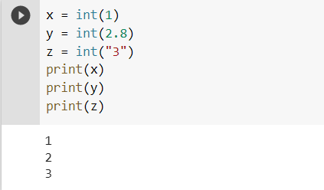
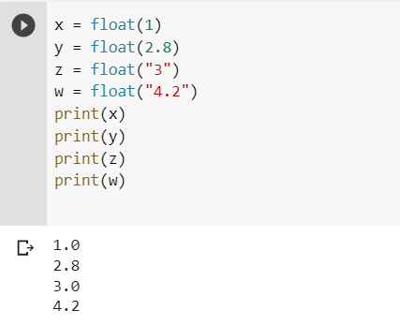
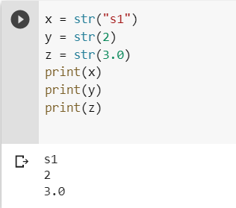
Example:
Integers:
Floats:
Strings:

Slide 61
Python Strings

Slide 62
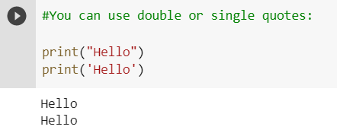
Strings
Strings in python are surrounded by either single quotation marks, or double quotation marks.
'hello' is the same as "hello".
You can display a string literal with the print() function:
Example:

Slide 63
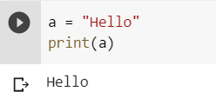
Assign String to a Variable
Assigning a string to a variable is done with the variable name followed by an equal sign and the string:
Example:

Slide 64
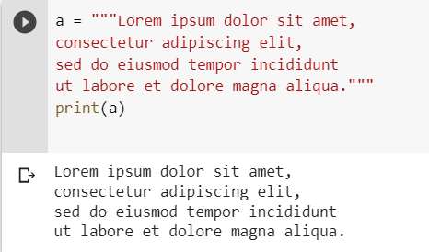
Multiline Strings
You can assign a multiline string to a variable by using three quotes:
Example:
You can use three double quotes:

Slide 65
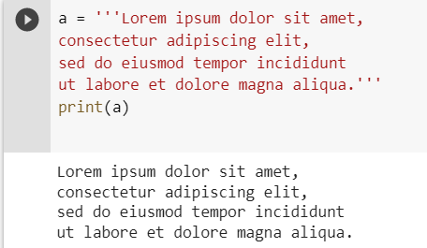
Or three single quotes:
Example:
Note: in the result, the line breaks are inserted at the same position as in the code.

Slide 66
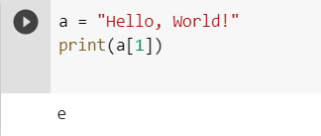
Strings are Arrays
Like many other popular programming languages, strings in Python are arrays of bytes representing unicode characters.
However, Python does not have a character data type, a single character is simply a string with a length of 1.
Square brackets can be used to access elements of the string.
Example:

Slide 67

Looping Through a String
Since strings are arrays, we can loop through the characters in a string, with a for loop.
Loop through the letters in the word “iloveyoumymoon":

Slide 68

String Length
To get the length of a string, use the len() function.
The len() function returns the length of a string:
Example:

Slide 69

Check String
To check if a certain phrase or character is present in a string, we can use the keyword in.
Check if "free" is present in the following text:
Example:

Slide 70


Use it in an if statement:
Print only if "free" is present:
Check if NOT
Check if "expensive" is NOT present in the following text:

Slide 71

Python - Slicing Strings
Slicing
You can return a range of characters by using the slice syntax.
Specify the start index and the end index, separated by a colon, to return a part of the string.
Get the characters from position 2 to position 5 (not included):

Slide 72

Slice From the Start
By leaving out the start index, the range will start at the first character:
Get the characters from the start to position 5 (not included):

Slide 73

Slice To the End
By leaving out the end index, the range will go to the end:
Get the characters from position 2, and all the way to the end:

Slide 74

Negative Indexing
Use negative indexes to start the slice from the end of the string:
Get the characters:
From: "o" in "World!" (position -5)
To, but not included: "d" in "World!" (position -2):

Slide 75

Python - Modify Strings
Python has a set of built-in methods that you can use on strings.
Upper Case
The upper() method returns the string in upper case:
Example:

Slide 76


Lower Case
The lower() method returns the string in lower case:
Example:
Remove Whitespace
Whitespace is the space before and/or after the actual text, and very often you want to remove this space.
The strip() method removes any whitespace from the beginning or the end:

Slide 77


Replace String
The replace() method replaces a string with another string:
Example:
Split String
The split() method returns a list where the text between the specified separator becomes the list items.

Slide 78

Python - String Concatenation
String Concatenation
To concatenate, or combine, two strings you can use the + operator.
Merge variable a with variable b into variable c:
Example:

Slide 79

Example
To add a space between them, add a " “:

Slide 80

Python - Format - Strings
String Format
As we learned in the Python Variables chapter, we cannot combine strings and numbers like this:
Example:

Slide 81

But we can combine strings and numbers by using the format() method!
The format() method takes the passed arguments, formats them, and places them in the string where the placeholders {} are:
Use the format() method to insert numbers into strings:
Example:

Slide 82


The format() method takes unlimited number of arguments, and are placed into the respective placeholders:
Example:
You can use index numbers {0} to be sure the arguments are placed in the correct placeholders:
Example:

Slide 83

Python - Escape Characters
Escape Character
To insert characters that are illegal in a string, use an escape character.
An escape character is a backslash \ followed by the character you want to insert.
An example of an illegal character is a double quote inside a string that is surrounded by double quotes:
Example:
You will get an error if you use double quotes inside a string that is surrounded by double quotes:

Slide 84

To fix this problem, use the escape character \":
The escape character allows you to use double quotes when you normally would not be allowed:
Example:

Slide 85

Escape Characters
Other escape characters used in Python:

Slide 86
Python - String Methods
String Methods
Python has a set of built-in methods that you can use on strings.
Note: All string methods return new values. They do not change the original string.

Slide 87


Slide 88


Slide 89
Python - String Exercises
Test Yourself With Exercises
Now you have learned a lot about Strings, and how to use them in Python.
Are you ready for a test?
Try to insert the missing part to make the code work as expected:

Slide 90

Exercise:
Use the len method to print the length of the string.

Slide 91
Python Booleans
Booleans represent one of two values: True or False.
Boolean Values
In programming you often need to know if an expression is True or False.
You can evaluate any expression in Python, and get one of two answers, True or False.
When you compare two values, the expression is evaluated and Python returns the Boolean answer:

Slide 92


Example:
When you run a condition in an if statement, Python returns True or False:
Print a message based on whether the condition is True or False:

Slide 93


Evaluate Values and Variables
The bool() function allows you to evaluate any value, and give you True or False in return,
Evaluate a string and a number:
Example:
Evaluate two variables:
Example:

Slide 94

Most Values are True
Almost any value is evaluated to True if it has some sort of content.
Any string is True, except empty strings.
Any number is True, except 0.
Any list, tuple, set, and dictionary are True, except empty ones.
The following will return True:

Slide 95

Some Values are False
In fact, there are not many values that evaluate to False, except empty values, such as (), [], {}, "", the number 0, and the value None. And of course the value False evaluates to False.
The following will return False:
Example:

Slide 96

One more value, or object in this case, evaluates to False, and that is if you have an object that is made from a class with a __len__ function that returns 0 or False:
Example:

Slide 97

Functions can Return a Boolean
You can create functions that returns a Boolean Value:
Print the answer of a function:
Example:

Slide 98

You can execute code based on the Boolean answer of a function:
Print "YES!" if the function returns True, otherwise print "NO!":
Example:

Slide 99

Python also has many built-in functions that return a boolean value, like the isinstance() function, which can be used to determine if an object is of a certain data type.
Check if an object is an integer or not:
Example:

Slide 100



Slide 101
Python Operators

Slide 102

Python Operators
Operators are used to perform operations on variables and values.
In the example below, we use the + operator to add together two values:
Example:

Slide 103

Python divides the operators in the following groups:
Arithmetic operators
Assignment operators
Comparison operators
Logical operators
Identity operators
Membership operators
Bitwise operators
Python Arithmetic Operators
Arithmetic operators are used with numeric values to perform common mathematical operations:

Slide 104

Python Assignment Operators
Assignment operators are used to assign values to variables:

Slide 105

Python Comparison Operators
Comparison operators are used to compare two values:

Slide 106


Python Logical Operators
Logical operators are used to combine conditional statements:
Python Identity Operators
Identity operators are used to compare the objects, not if they are equal, but if they are actually the same object, with the same memory location:

Slide 107


Python Membership Operators
Membership operators are used to test if a sequence is presented in an object:
Python Bitwise Operators
Bitwise operators are used to compare (binary) numbers:

Slide 108



Slide 109
Python Lists ❮ Previo

Slide 110


List
Lists are used to store multiple items in a single variable.
Lists are one of 4 built-in data types in Python used to store collections of data, the other 3 are Tuple, Set, and Dictionary, all with different qualities and usage.
Lists are created using square brackets:
Example:

Slide 111
List Items
List items are ordered, changeable, and allow duplicate values.
List items are indexed, the first item has index [0], the second item has index [1] etc.
Ordered
When we say that lists are ordered, it means that the items have a defined order, and that order will not change.
If you add new items to a list, the new items will be placed at the end of the list.
Changeable
The list is changeable, meaning that we can change, add, and remove items in a list after it has been created.

Slide 112

Allow Duplicates
Since lists are indexed, lists can have items with the same value:
Lists allow duplicate values:
Example:

Slide 113


List Length
To determine how many items a list has, use the len() function:
Print the number of items in the list:
List Items - Data Types
List items can be of any data type:

Slide 114


A list can contain different data types:
A list with strings, integers and boolean values:
type()
From Python's perspective, lists are defined as objects with the data type 'list':

Slide 115


What is the data type of a list?
The list() Constructor
It is also possible to use the list() constructor when creating a new list.
Using the list() constructor to make a List:

Slide 116
Python Collections (Arrays)
There are four collection data types in the Python programming language:
List is a collection which is ordered and changeable. Allows duplicate members.
Tuple is a collection which is ordered and unchangeable. Allows duplicate members.
Set is a collection which is unordered, unchangeable*, and unindexed. No duplicate members.
Dictionary is a collection which is ordered** and changeable. No duplicate members.

Slide 117

Python - Access List Items
Access Items
List items are indexed and you can access them by referring to the index number:
Print the second item of the list:

